Slide 1
Lower Bounds on Tree Covers
Hangyu Xu
University of Science and Technology of China
Based on joint work with Yu Chen (NUS) and Zihan Tan (UMN)

Slide 2
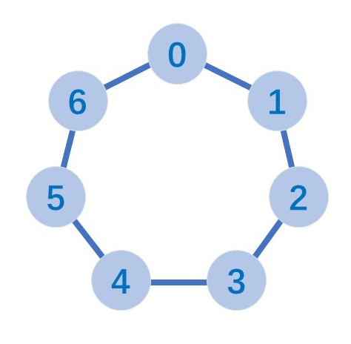
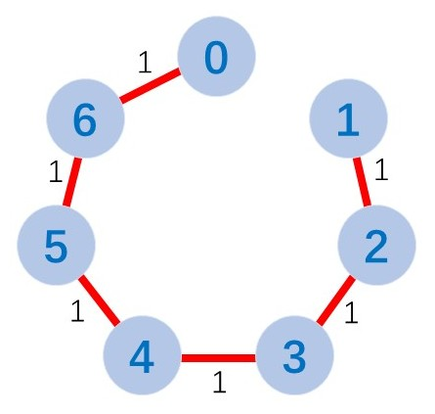
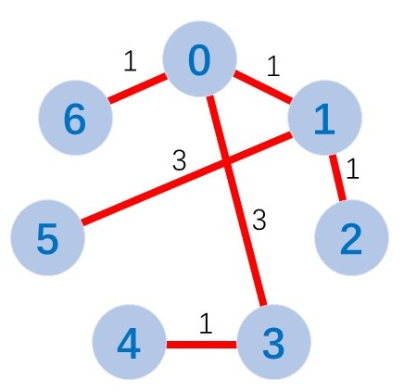
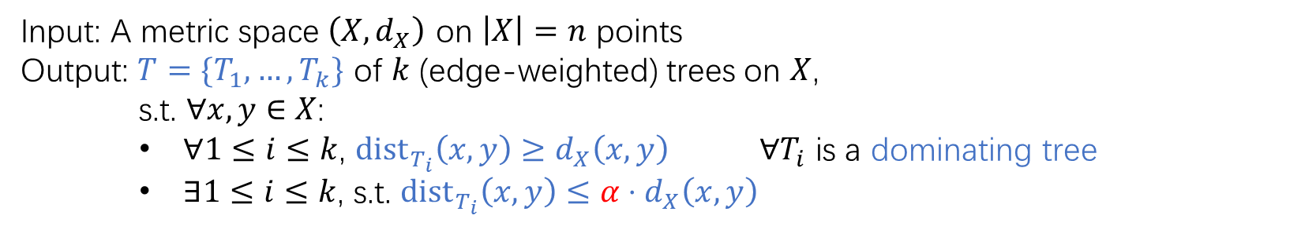


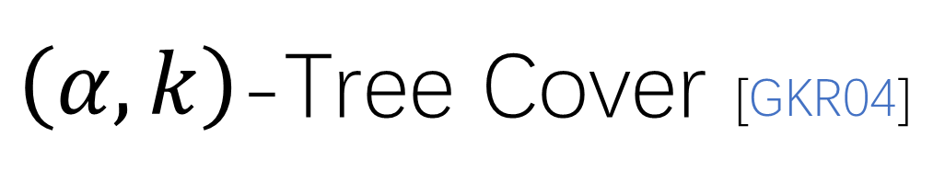
$\left(α,k\right)$-Tree Cover [GKR04]
Input: A metric space $\left(X,d_{X}\right)$ on $\left|X\right|=n$ points
Output: $T=\{T_{1},…,T_{k}\}$ of $k$ (edge-weighted) trees on $X$,
s.t. $∀x,y∈X$:
    $∀1≤i≤k$, ${dist}_{T_{i}}\left(x,y\right)≥d_{X}\left(x,y\right)$ $∀T_{i}$ is a dominating tree
    $∃1≤i≤k$, s.t. ${\text{dist}}_{T_{i}}\left(x,y\right)≤α⋅d_{X}\left(x,y\right)$
distortion/stretch
$$T_{1}$$
$$T_{2}$$

Slide 3
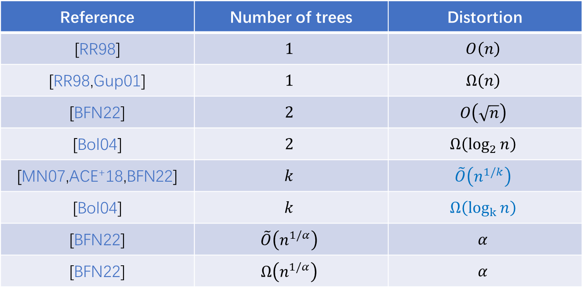
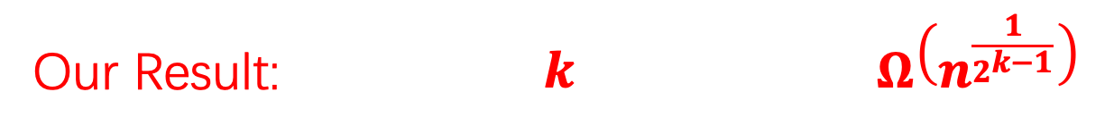
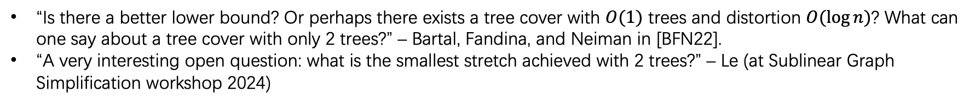
Previous Work
Reference | Number of trees | Distortion
[RR98] | $$1$$ | $$O\left(n\right)$$
[RR98,Gup01] | $$1$$ | $$Ω\left(n\right)$$
[BFN22] | $$2$$ | $$O\left(\sqrt{n}\right)$$
[Bol04] | $$2$$ | $$Ω\left(\log_{2}{n}\right)$$
[MN07,ACE⁺18,BFN22] | $$k$$ | $$\tilde{O}\left(n^{1/k}\right)$$
[Bol04] | $$k$$ | $$Ω\left(\log_{k}{n}\right)$$
[BFN22] | $$\tilde{O}\left(n^{1/α}\right)$$ | $$α$$
[BFN22] | $$Ω\left(n^{1/α}\right)$$ | $$α$$
Our Result: $k$ $Ω\left(n^{\frac{1}{2^{k−1}}}\right)$
connection to combinatorial fixed-point theorems
“Is there a better lower bound? Or perhaps there exists a tree cover with $O(1)$ trees and distortion $O(log⁡n)$? What can one say about a tree cover with only 2 trees?” – Bartal, Fandina, and Neiman in [BFN22].
“A very interesting open question: what is the smallest stretch achieved with 2 trees?” – Le (at Sublinear Graph Simplification workshop 2024)

Slide 4
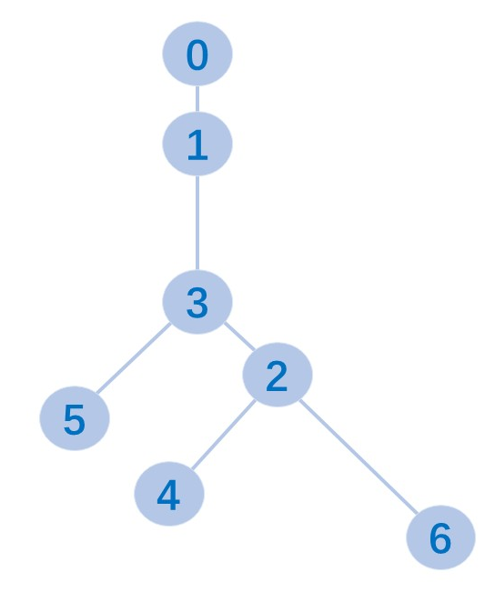
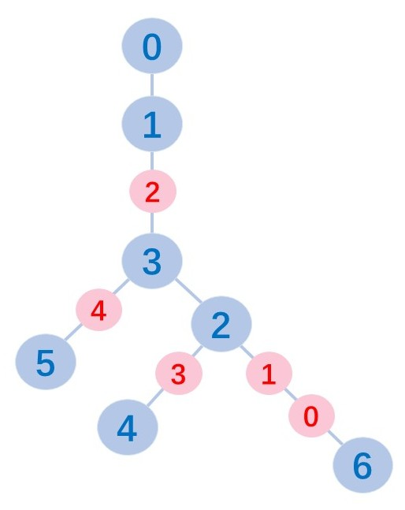
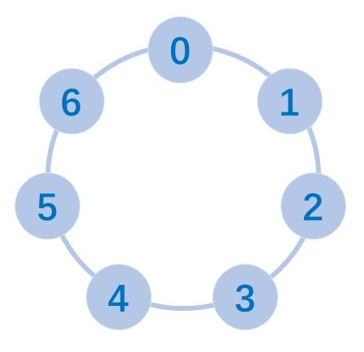
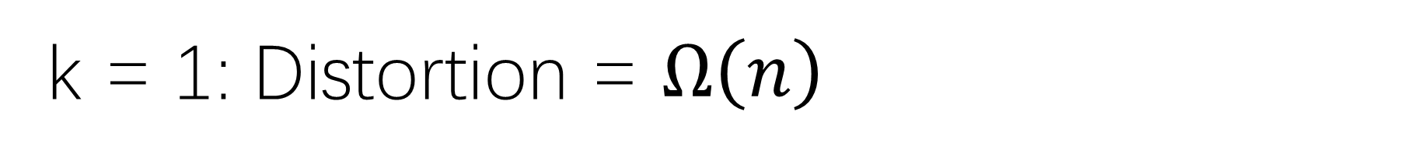
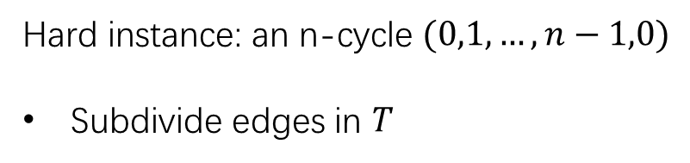
k = 1: Distortion = $Ω\left(n\right)$
Similar to [RR98] and [Gup01]
Hard instance: an n-cycle $(0,1,…,n−1,0)$
Subdivide edges in $T$

Slide 5
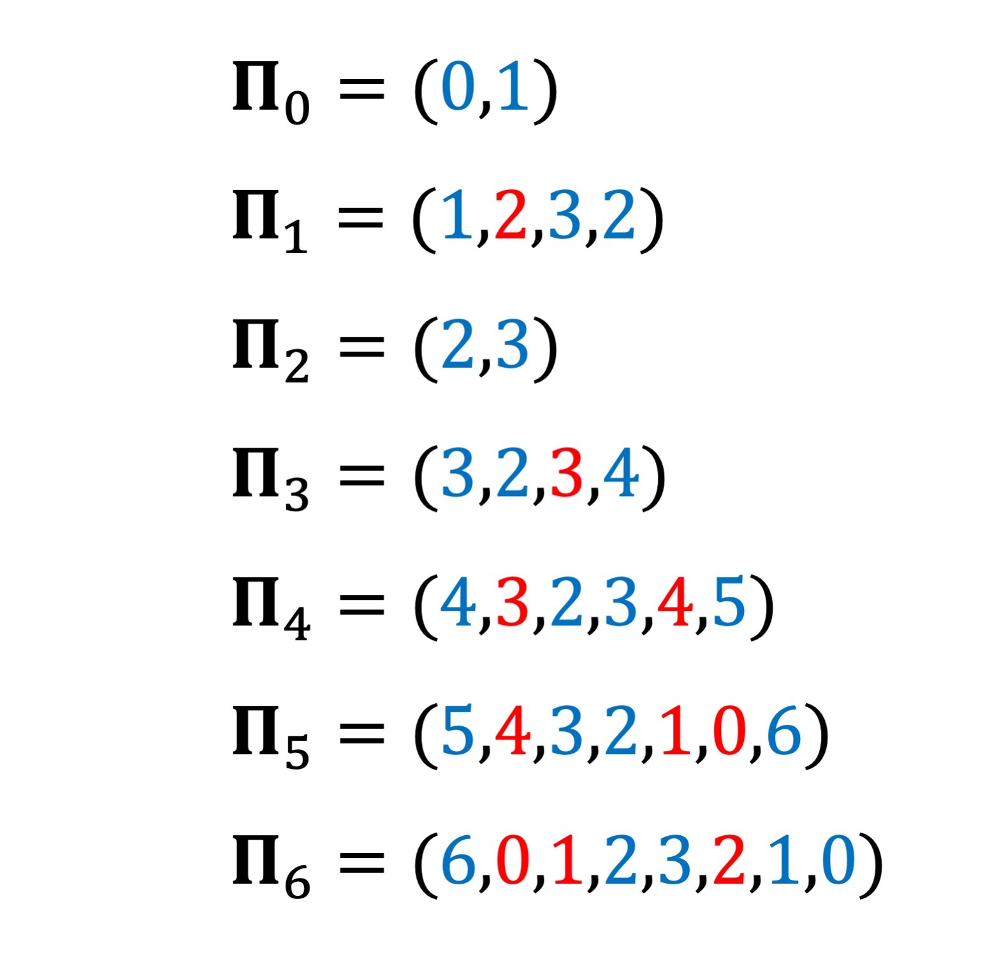
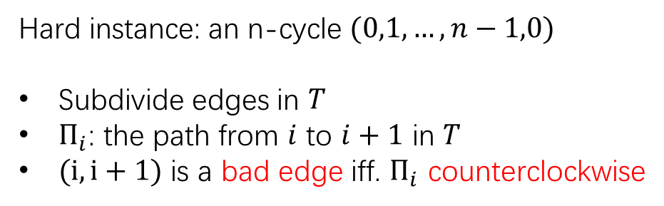
k = 1: Distortion = $Ω\left(n\right)$
Similar to [RR98] and [Gup01]
Hard instance: an n-cycle $(0,1,…,n−1,0)$
Subdivide edges in $T$
$Π_{i}$: the path from $i$ to $i+1$ in $T$
$(i,i+1)$ is a bad edge iff. $Π_{i}$ counterclockwise
(5,6): bad edge
always exists in a cycle

Slide 6
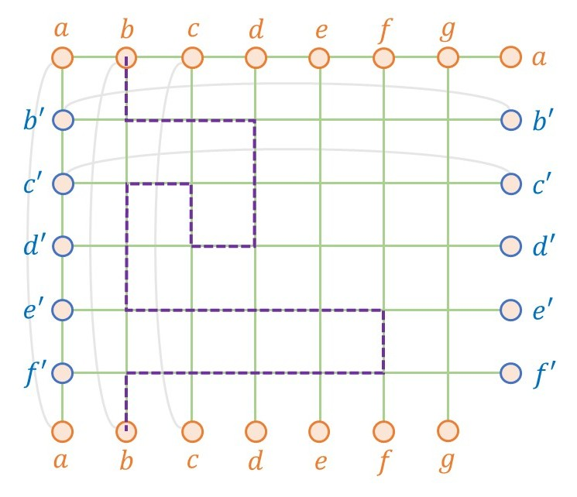
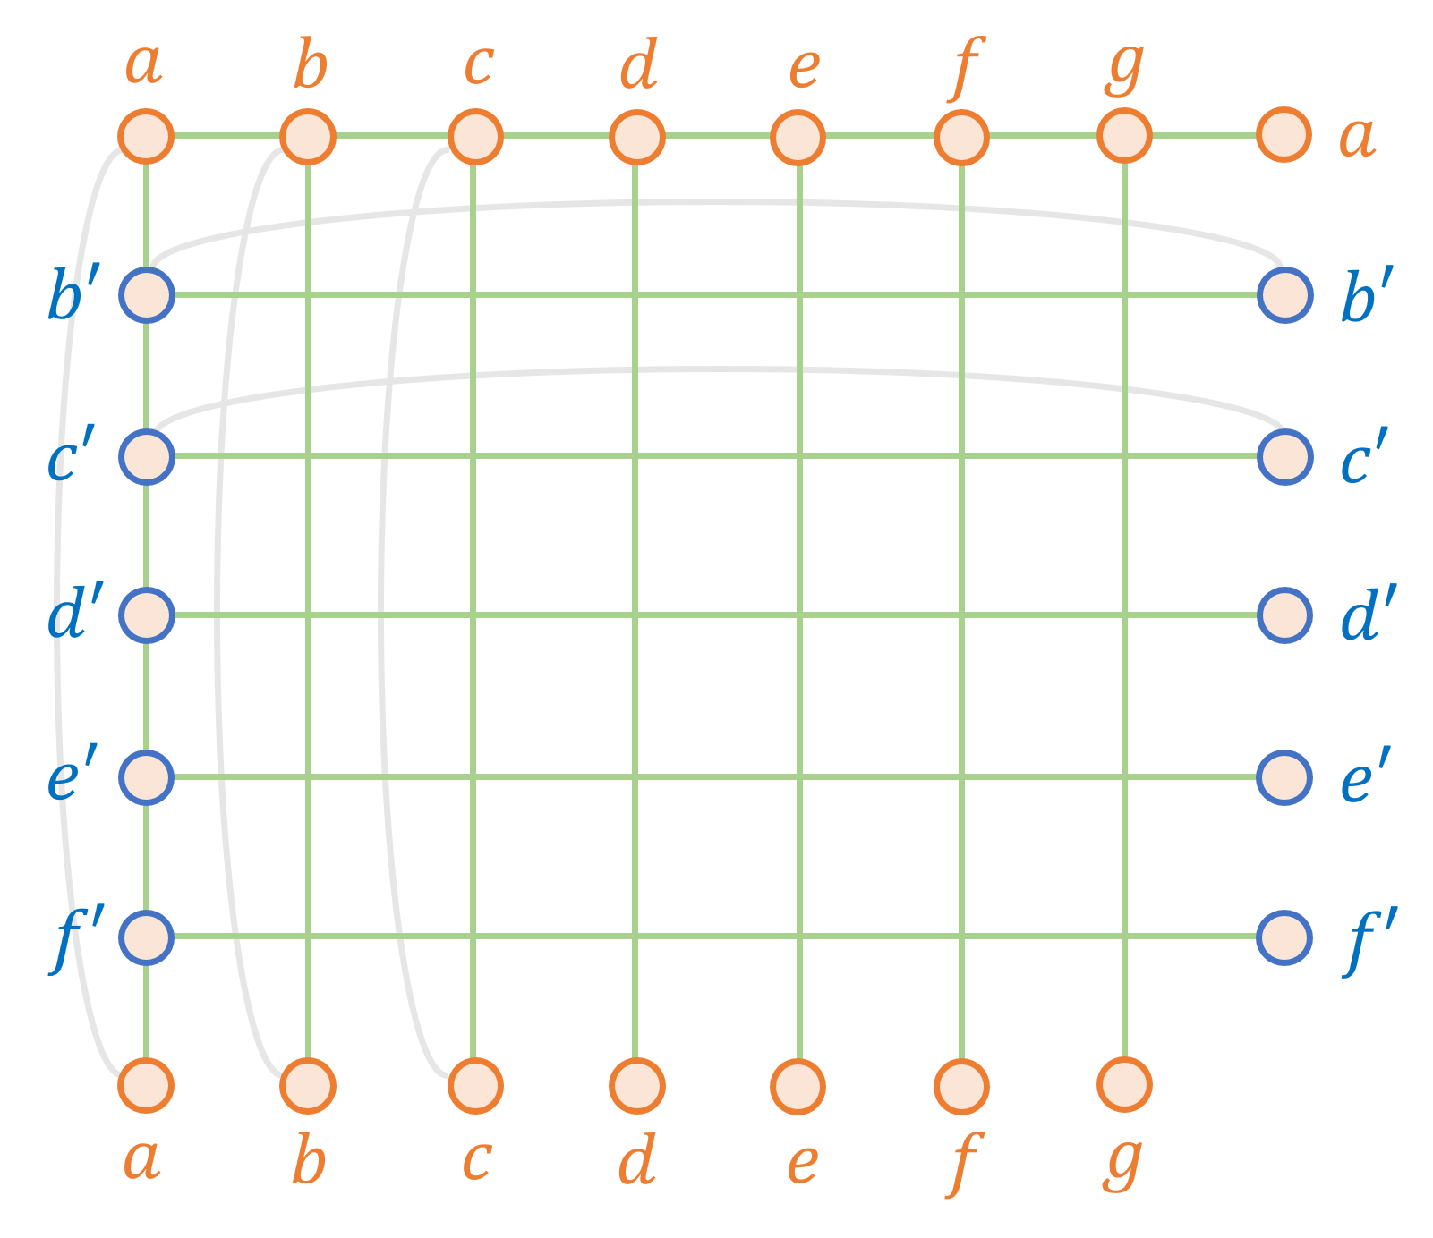
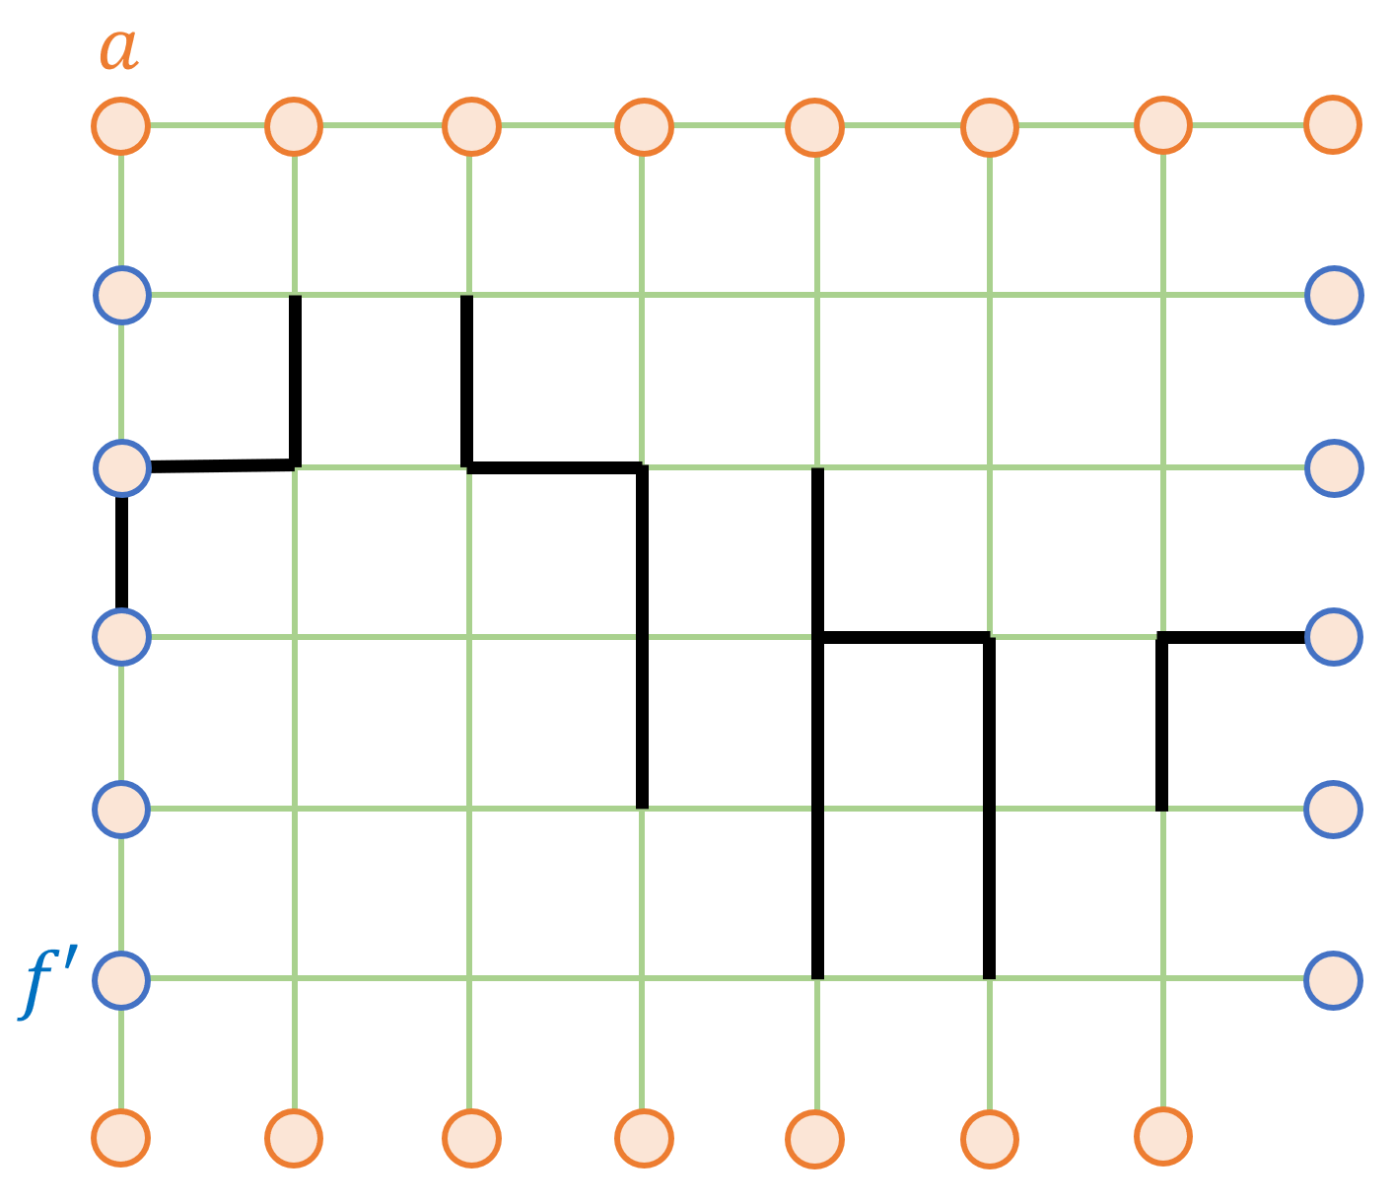
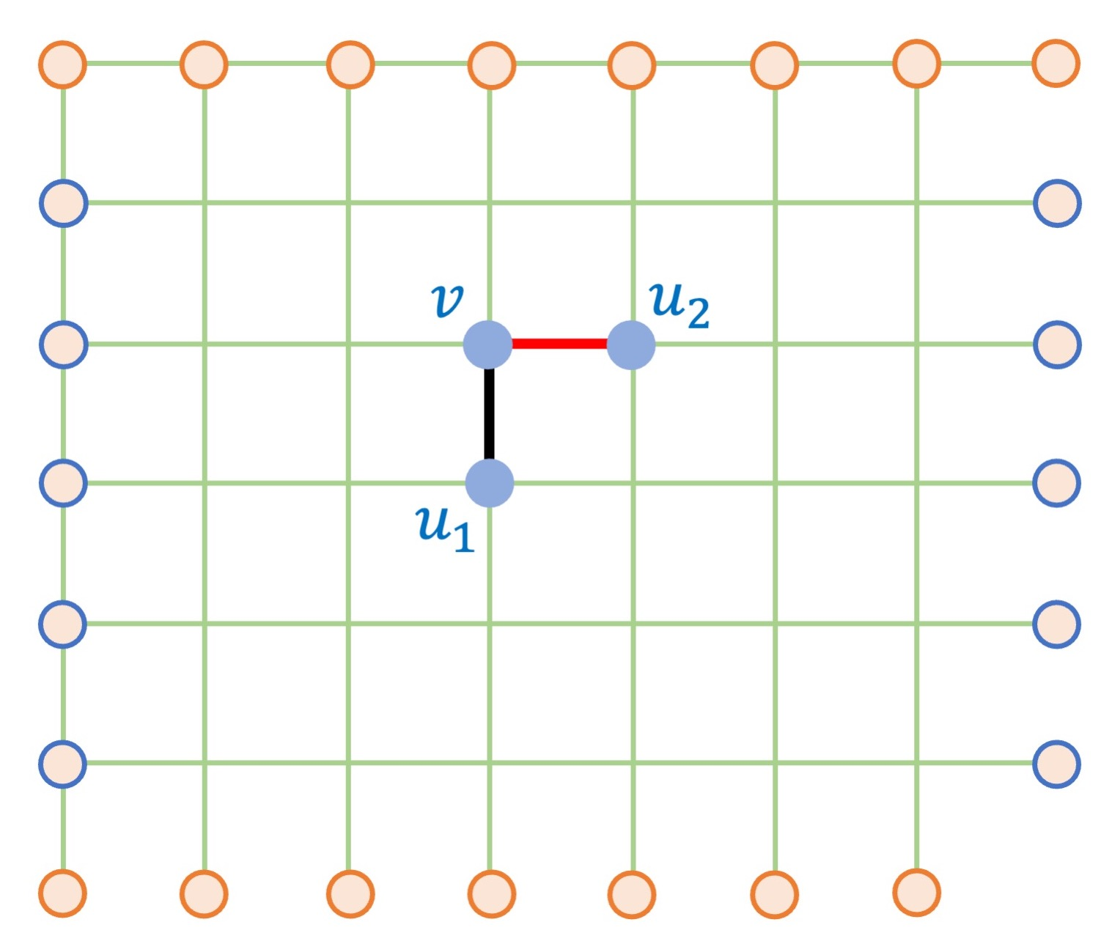
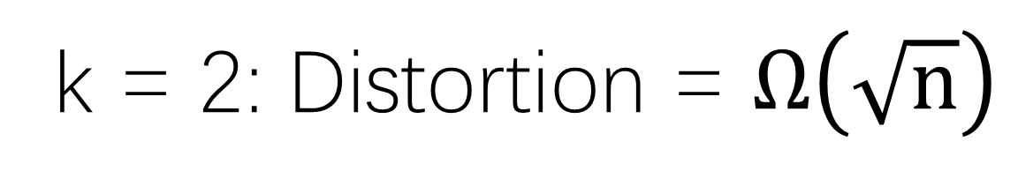
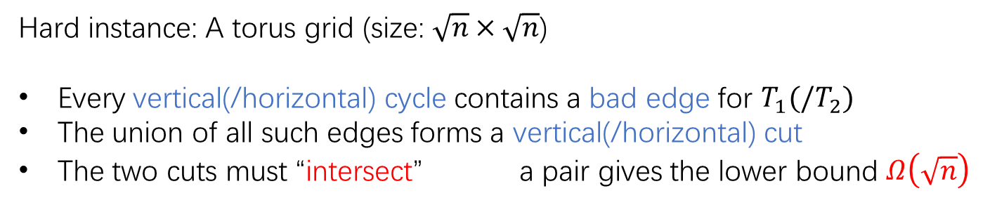
k = 2: Distortion = $Ω\left(\sqrt{n}\right)$
Grid can be covered by 2 trees in constant factor. [CTX25,LMSZ25,BKT25]
Hard instance: A torus grid (size: $\sqrt{n}×\sqrt{n}$)
Every vertical(/horizontal) cycle contains a bad edge for $T_{1}(/T_{2})$
The union of all such edges forms a vertical(/horizontal) cut
The two cuts must “intersect” a pair gives the lower bound $Ω\left(\sqrt{n}\right)$

Slide 7
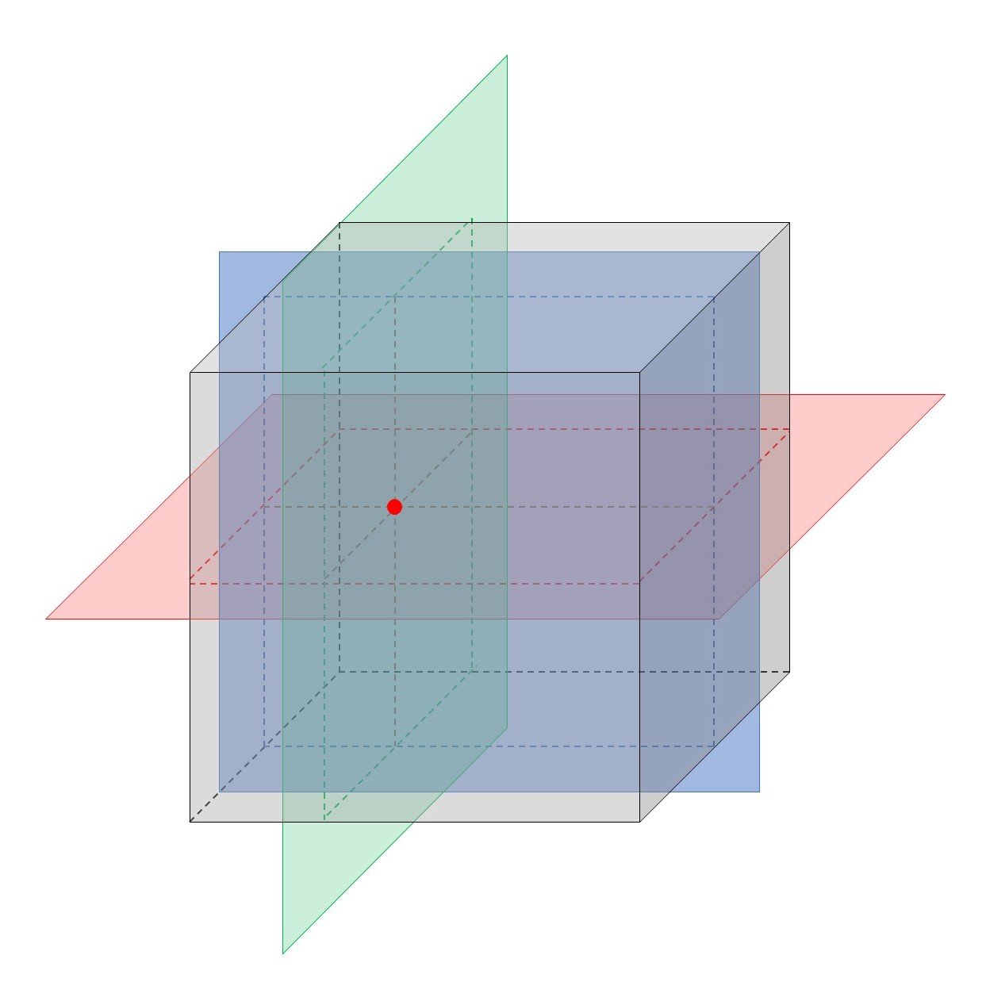
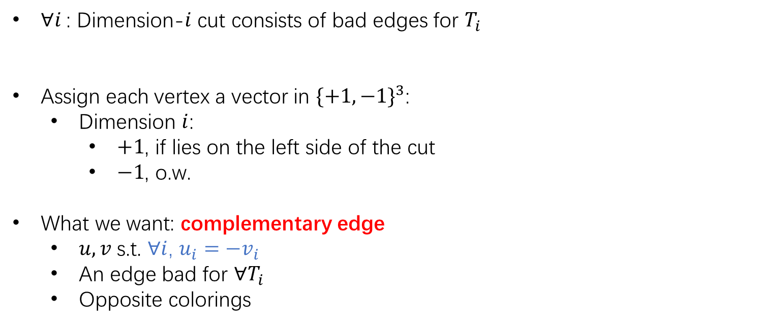
k = 3: Connection to Topology
$∀i$: Dimension-$i$ cut consists of bad edges for $T_{i}$
Assign each vertex a vector in $\{+1,−1\}^{3}$:
  Dimension $i$:
    $+1$, if lies on the left side of the cut
    $−1$, o.w.
What we want: complementary edge
  $u,v$ s.t. $∀i$, $u_{i}=−v_{i}$
  An edge bad for $∀T_{i}$
  Opposite colorings
not work
coloring
l.b. for tree cover
connecting to combinatorial fixed-point theorems

Slide 8
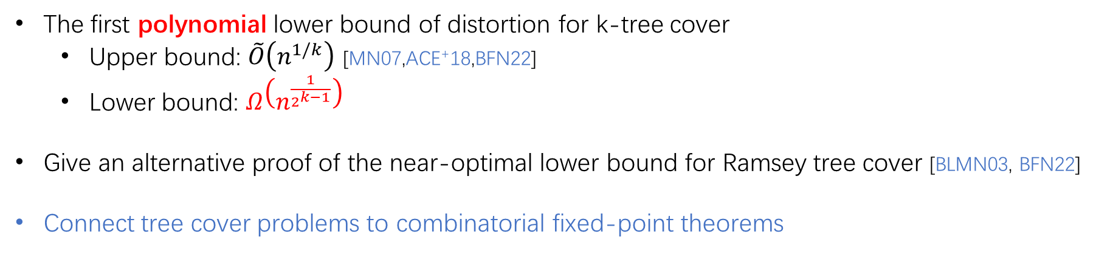
Summary
The first polynomial lower bound of distortion for k-tree cover
  Upper bound: $\tilde{O}\left(n^{1/k}\right)$ [MN07,ACE⁺18,BFN22]
  Lower bound: $Ω\left(n^{\frac{1}{2^{k−1}}}\right)$
Give an alternative proof of the near-optimal lower bound for Ramsey tree cover [BLMN03, BFN22]
Connect tree cover problems to combinatorial fixed-point theorems
Thanks for listening!

Slide 9
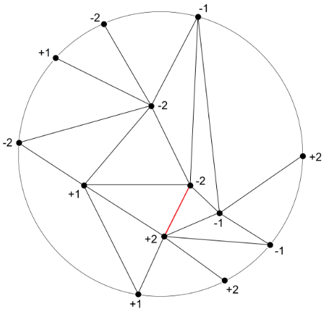
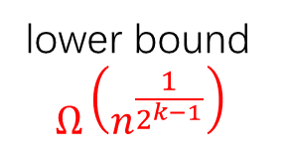
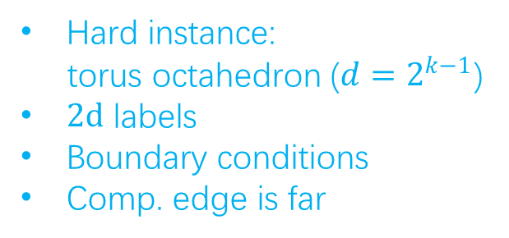

Tucker’s Lemma
$Γ$ is a triangulation of d-dimension unit ball
$ℓ$ is a labeling:
  $ℓ:V\left(Γ\right)→\{−l_{d},…,−l_{2},−l_{1},l_{1},l_{2},…,l_{d}\}$
  $ℓ\left(v\right)=−ℓ\left(−v\right)$ for all $v∈$ boundary
Then $Γ$ contains a complementary edge
coloring
an edge with opposite labels
Hard instance:
torus octahedron ($d=2^{k−1}$)
$2d$ labels
Boundary conditions
Comp. edge is far
lower bound
$$Ω\left(n^{\frac{1}{2^{k−1}}}\right)$$
https://en.wikipedia.org/wiki/Tucker's_lemma

